Slide 1
18MES103L – WORKSHOP LAB
MAKE A CROSS HALVING JOINT OF TWO WOODEN PIECES AT PERPENDICULAR DIRECTION.
SRMIST
MECHANICAL DEPT
RAMAPURAM CAMPUS
D.K.MOHAN KUMAR ,A.P(SR.G),MECH DEPT

Slide 2
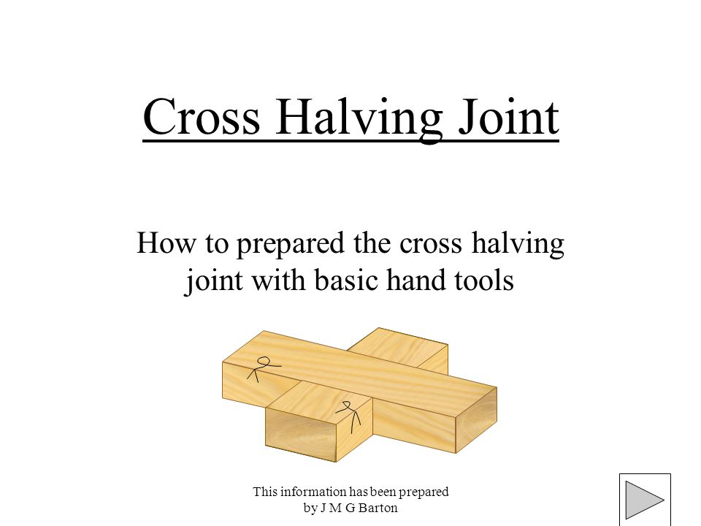
D.K.MOHAN KUMAR ,A.P(SR.G),MECH DEPT

Slide 3
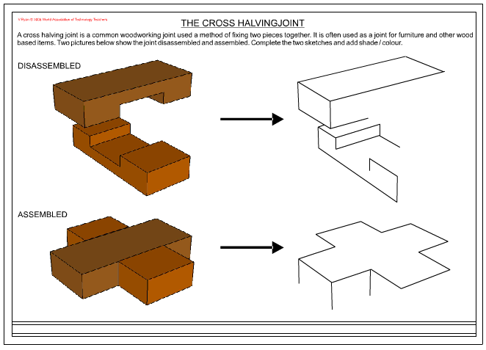
D.K.MOHAN KUMAR ,A.P(SR.G),MECH DEPT

Slide 4
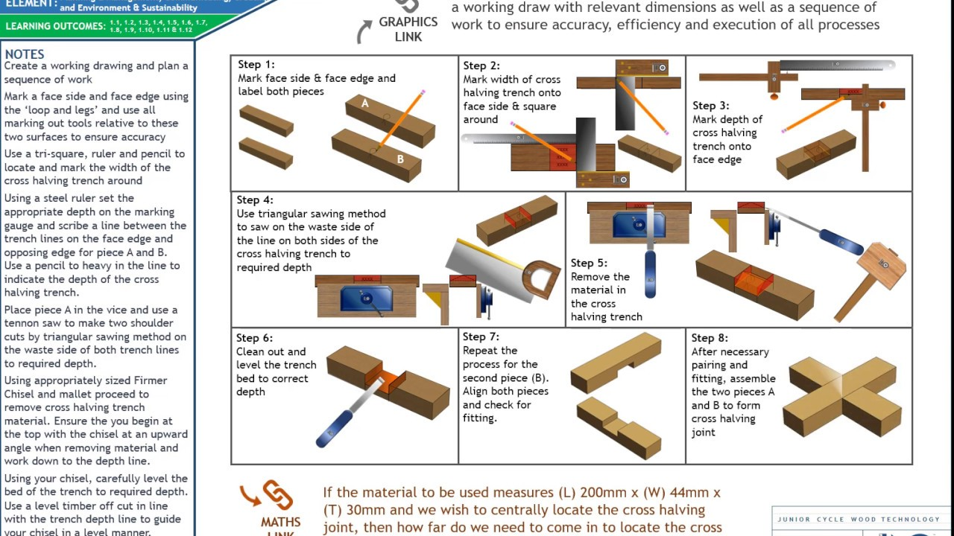
D.K.MOHAN KUMAR ,A.P(SR.G),MECH DEPT

Slide 5
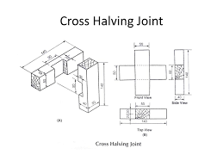
D.K.MOHAN KUMAR ,A.P(SR.G),MECH DEPT

Slide 6
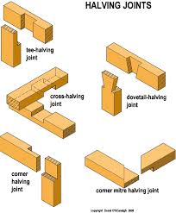
D.K.MOHAN KUMAR ,A.P(SR.G),MECH DEPT

Slide 7
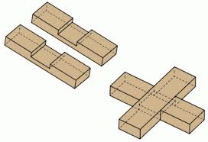
D.K.MOHAN KUMAR ,A.P(SR.G),MECH DEPT

Slide 8
D.K.MOHAN KUMAR ,A.P(SR.G),MECH DEPT

